Slide 1
FBI Virtual Case File – Project Management Analysis
Shweta Balasubramanian
Jyothsna Chivukula
Shatakshi Narayan
Meghana Kasula
Garima Rawat
Kokila Dular
Sofia Arora

Slide 2
Agenda
Project Overview
Project Management Documents
Project Charter
WBS/GANTT Chart
RACI Matrix & MOM
Project Status Report
Budget Report
Risk Management
Ishikawa Diagram
Pairwise Comparison
Problems Identified
References

Slide 3
About FBI
Notes:
Garima

Slide 4



AMBITION OF THE FBI TRILOGY PROJECT
Upgrade the FBI’s network infrastructure.
Upgrade the FBI’s case management system (VCF) to enable better access to, and sharing of, case-related information across the FBI.
Upgrade software and hardware for FBI agents.
Notes:
Garima

Slide 5

Project timeline
2000
2001
2002
2003
2004
2005
Congress provided $379.8 million for FBI IT Upgrade Project
Congress provided additional $78 million
FBI requested $70 million from Congress;$78 million approved
SAIC worked on change submitted by FBI
Dyncorp delivered Trilogy’s infrastructure 2 years behind schedule
Aerospace issued report on VCF
Dyncorp awarded $51 million for infrastructure projects
VCF project ended while still in development stage
SAIC delivered prototype VCF with 17 deficiencies
Sherry Higgins hired = Office of Program Management
Aerospace Corp asked to evaluate VCF
SAIC awarded $14.7 million for software upgrades
SAIC engineers defined new system requirements for VCF
Higgins and Depew
quit
Cost nearly $170 million
Robert S. Mueller appointed as FBI director
Patton hired by SAIC to review VCF documents
Robert Chiaradio & Agent Depew hired
Need for new DB system raised
Congress increased funding ($123.2 million)
FBI told SAIC to develop VCF
Notes:
Garima

Slide 6

Best Project Management Practices

Slide 7
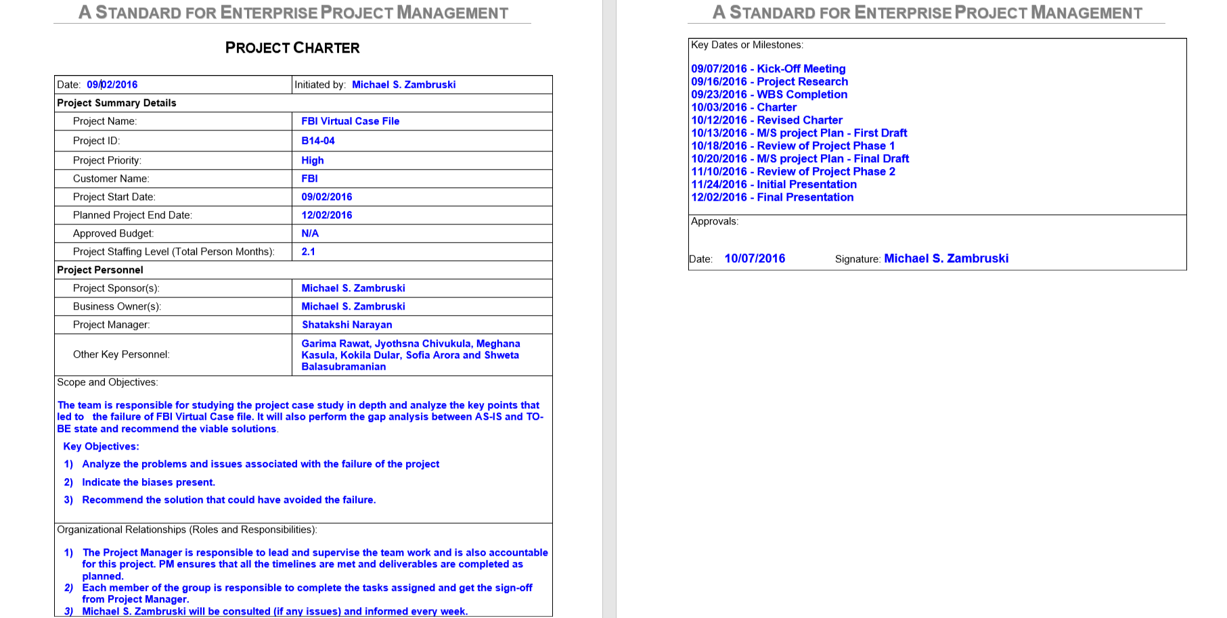
The Manager, The Organization & The Team - Project Charter
Priority Matrix
 | High (Most Constrained) | Medium (Some Constrained) | Low (Least Constrained)
Scope | X
Cost |  |  | X
Time |  | X

Slide 8

Budgeting the Project - Budget Report
Actual Cost: $15,175
Project Manager salary: $50 /hour Graduate: $40 /hour Undergraduate: $30 /hour

Slide 9
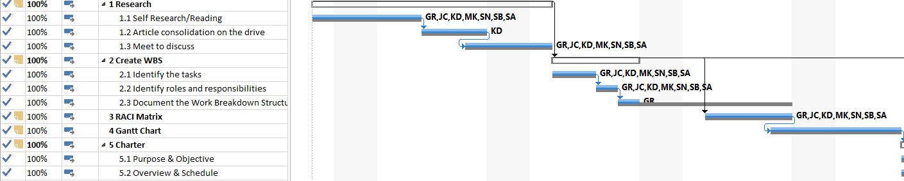
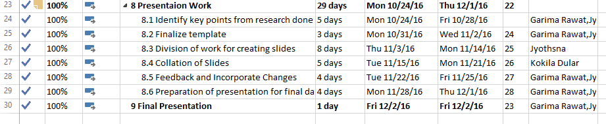
Scheduling the Project & Allocating Resources -WBS/GANTT Chart
Baseline

Slide 10
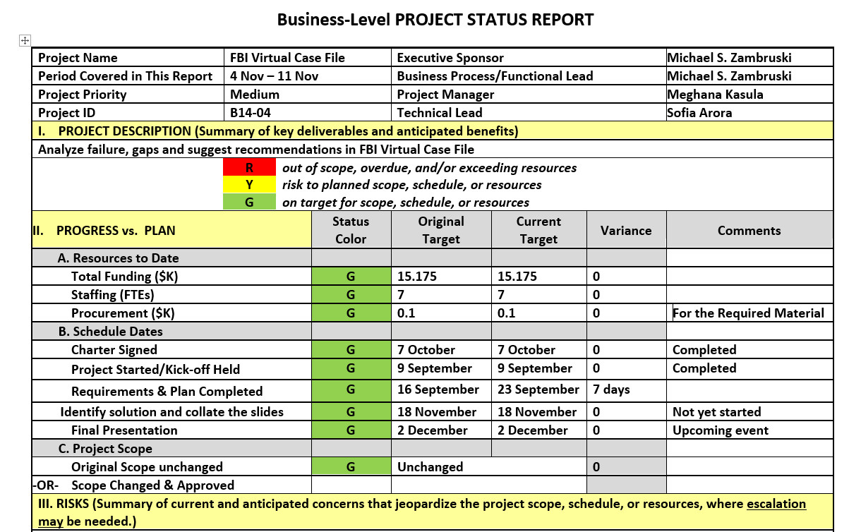
Control & Monitor - Project Status Report

Slide 11
Control & Monitor - RACI Matrix and Meeting Practices
Task Name | Kokila D | Garima R | Jyothsna C | Meghana K | Shatakshi N | Shweta B | Sofia A | Mike Z
Research
Create WBS
RACI Matrix
Gantt Chart
Charter
Final Charter
M/S project Plan
Presentaion Work
Final Presentation
Meeting Date | 3rd October, 2016
Attendees | KD, GR, MK, SA, SN, SB, JC
Project Manager | Jyothsna
Agenda | 1. Update Project Charter
 | 2. Update WBS
 | 3. FBI Research Progress
Action Items | 1. PM send updated Charter
 | 2. Watch MPP video
Project Manager | Status Check for Submissions & Class Reads
 | 9-Sep | 16-Sep | 23-Sep | 30-Sep | 7-Oct | 14-Oct | 21-Oct | 28-Oct | 4-Nov | 11-Nov | 18-Nov
Kokila D
Garima R
Jyothsna C
Meghana K
Shatakshi N
Shweta B
Sofia A

Slide 12

Project activity and Risk Planning

Slide 13
Ishikawa Diagram

Slide 14
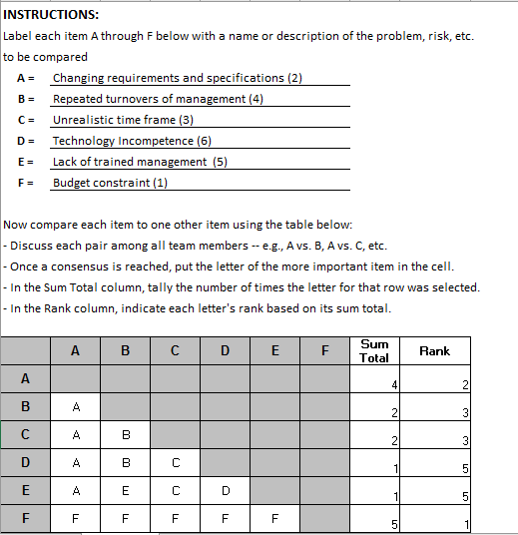
Pairwise Comparison
Pairwise comparison is one of the methods used for prioritization.
In a Team setup, Points are calculated for prioritized items by voting from the team members.
The team would prioritize the projects, issues based on the points each item obtained.

Slide 15
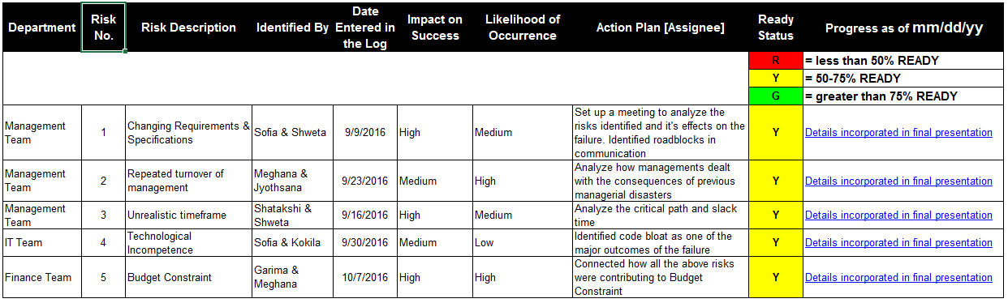
Issue Risk Log

Slide 16

Problems Identified

Slide 17
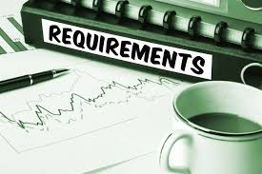

Scope
Problem Faced:
Biases:
Recommendations:
Ill defined requirements
Available Data
Requirement analysis
Scope Creep
Illusion of Control
Plan before act / Requirement analysis
Notes:
Meghana Shatakshi Kokila

Slide 18



Human Resources
Problem Faced:
Biases:
Recommendations:
Inadequate skillset of PM
Over Confidence
Human capital management
Lack of engineering discipline
Illusion Of Control
Training of Resources
Frequent turnover
Group Think & Sunk Cost
When to Pull the Plug
Notes:
Meghana Shatakshi Kokila

Slide 19
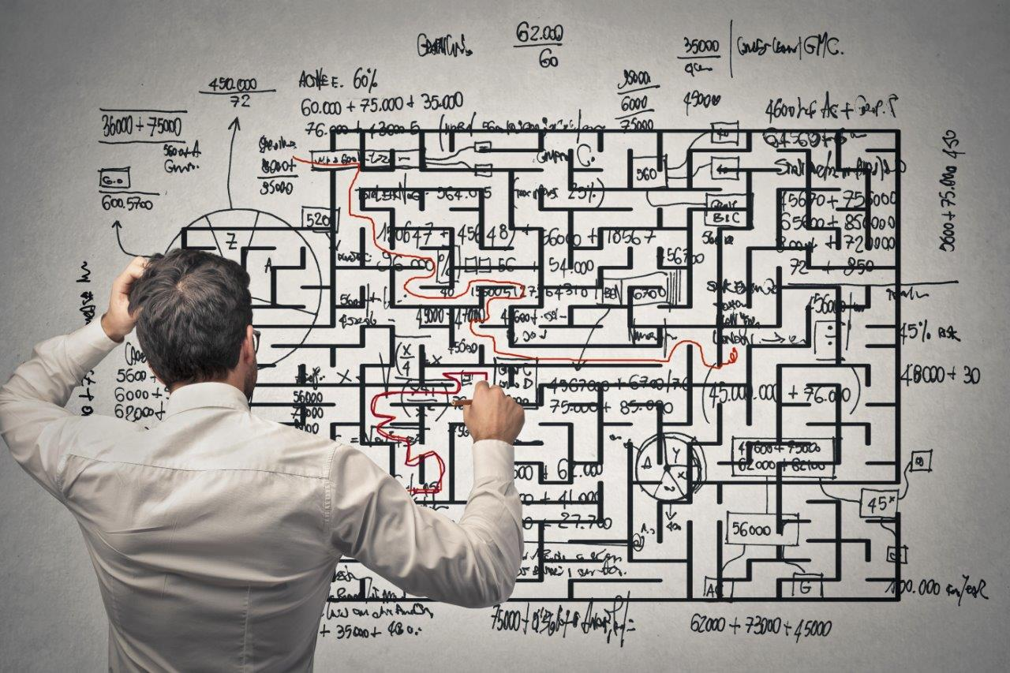
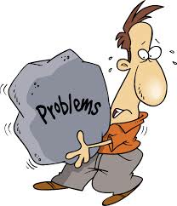
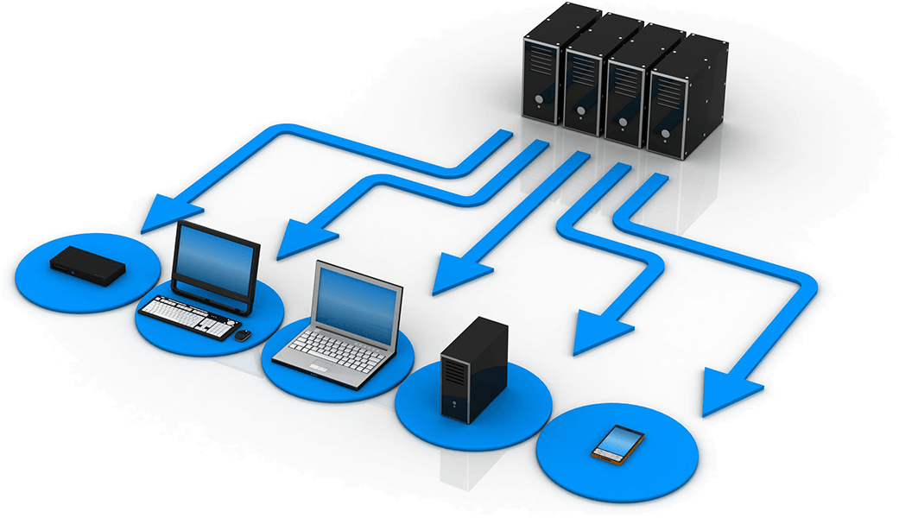
Planning
Problem Faced:
Biases:
Recommendations:
No software infrastructure
Illusion of Control
Detailed Analysis of As is
and To Be
Underestimation of Complexity
Overconfidence and Group Think
Detailed Analysis of As is
and To Be
Progress without correcting issues
Conservatism
Audit and Best Practices Training
Notes:
Meghana Shatakshi Kokila

Slide 20

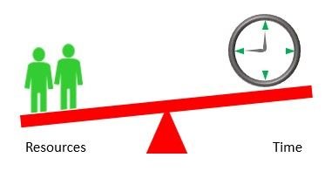

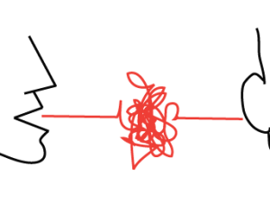
Organization culture
Problem Faced:
Biases:
Recommendations:
No testing /feedback
Overconfidence
Setting up Milestone
Scheduling done by outcome not resources
Overconfidence
Managerial Training
Flash cutover
Overconfidence and Group Think
Back Up Plan
No proper communication channels
Conservatism
Whistle Blower Award
Notes:
Meghana Shatakshi Kokila

Slide 21
Bias Summary
Issue | Available Data | Conservatism | Escalation of Commitment | Group Think | Illusion of Control | Over- confidence | Recency | Selective Perception | Sunk Cost
Scope
Human Resources
Planning
System
Notes:
Meghana

Slide 22
Evaluating and terminating the project

Slide 23
When to pull the plug
Individual
Assess yourself as Manager
Assess the project without thinking about sunk cost
Organization
Separate Decision Makers
Avoiding strong fear of failure
Self-justification
Use of outside experts and consultants for evaluation
Rational Evaluation
Over commitment
recognizes

Slide 24
References
Project Management in Practice, 5th Edition, Meredith, Mantel, Shafer & Sutton ,Wiley and Sons, Inc., 2014
A Standard for Enterprise Project Management, Zambruski, CRC Press, 2008
The Enterprise Triple Constraint by Michael S. Zambruski - October 2, 2014
The necessary art of persuasion by Book by Jay Alden Conger
Knowing When to Pull the Plug Barry M.Staw & Jerry Ross

Slide 25


